Slide 1
National Security Agency
by Julian Meyer

Slide 2
AFSA
NSA Predecessor
In charge of communications
Had little power in reality
Abolished in 1952

Slide 3
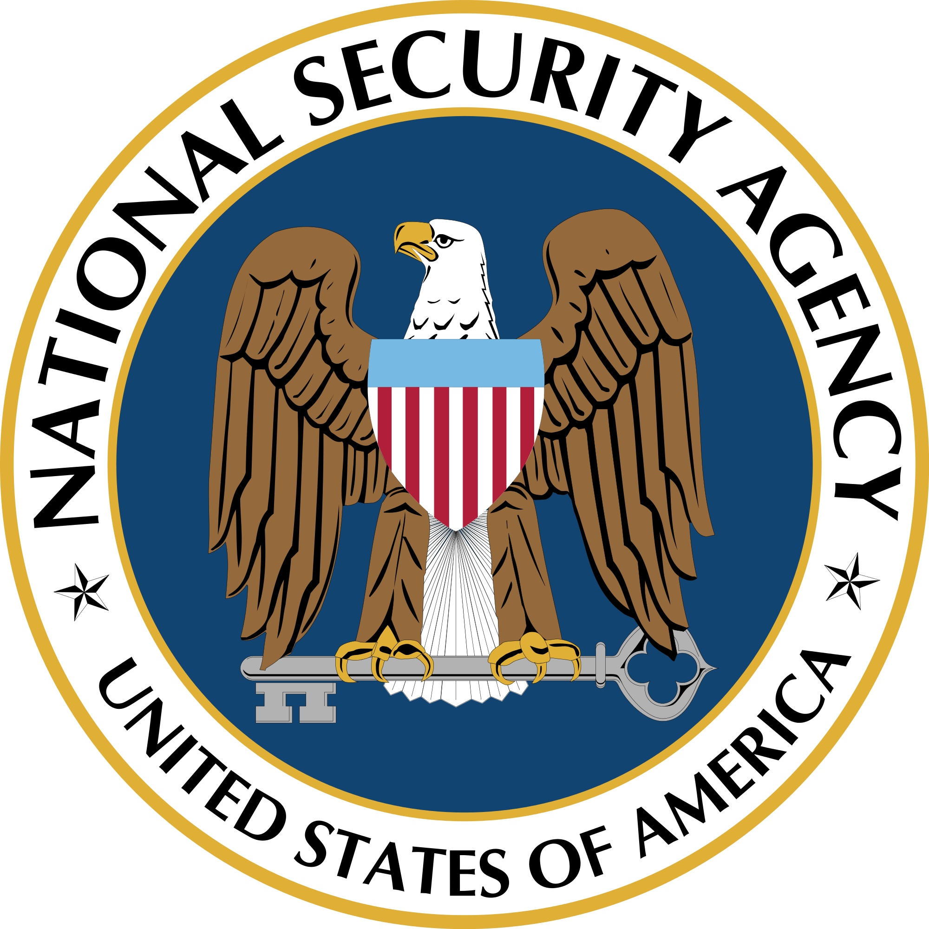
NSA Formation - Role of the NSA
within, but not a part of the Department of Defense
“direct and manage” electronic intelligence of the armed forces

Slide 4
NSA Formation - Charter
permission for an organization
“SIGINT” - administer any communications in the US
“COMINT” - monitored communications sent by the armed forces
“ELINT” - monitored the signals emitted by radar during testing

Slide 5
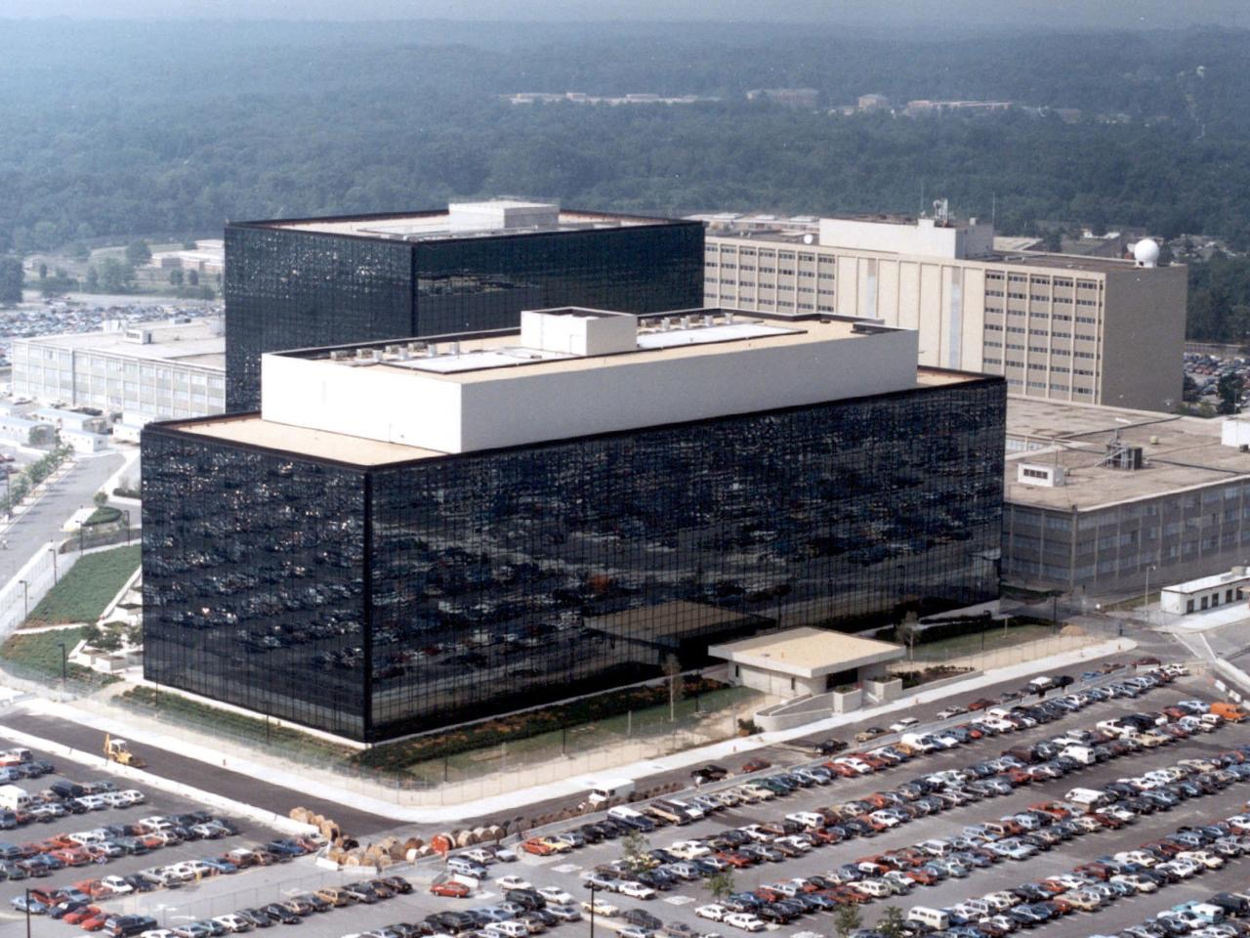
NSA Formation - Details
20 thousand employees in 3 buildings
$4 billion a year

Slide 6
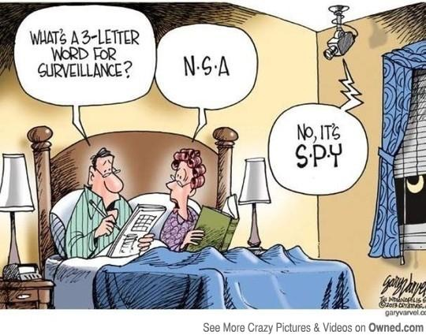
Causes
Government needed an agency to monitor electronic intelligence
needed for criminal investigations
regulated by the FISC
  business records or tangible things
  could have secret meanings

Slide 7
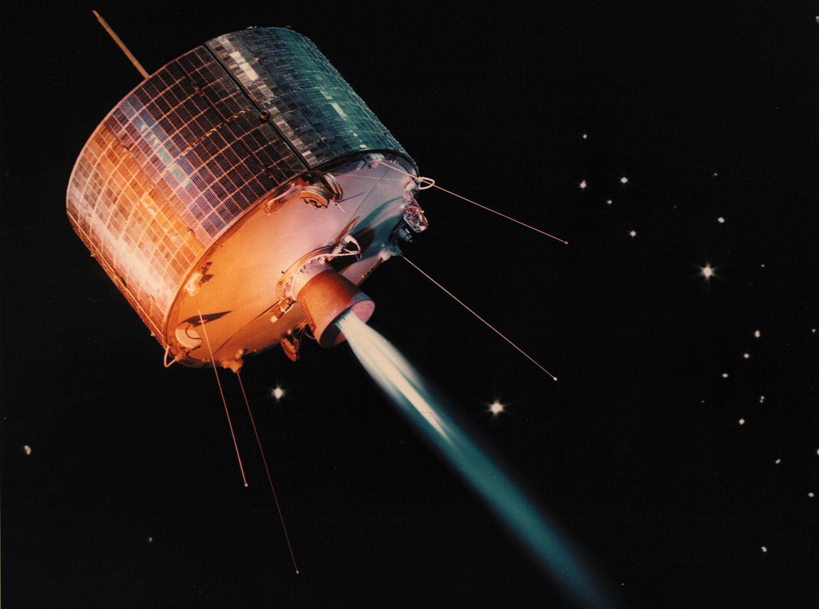
How did the NSA do this?
Geosynchronous satellites intercept communications through civilian satellites
Ask telephone companies for call records
  Allow them to say no
  None ever do

Slide 8
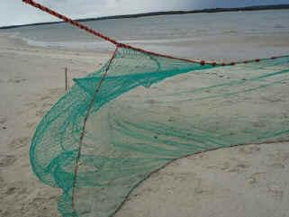
Effects
Dragnet surveillance
  capture everything
  like a dragnet
  technically illegal
  “only metadata”
    who you call at what time

Slide 9
Effects
Criticism
Edward Snowden
  Leaked documents containing information about the NSA
  charged Snowden with Espionage
  got asylum in Russia
  won Swedish Independence Award

Slide 10
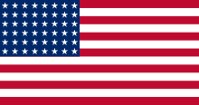
Effects
Independence from Britain
  mass surveillance is why we split from Britain
4th amendment
  secret surveillance violates this amendment
  mass surveillance without probable cause

Slide 11
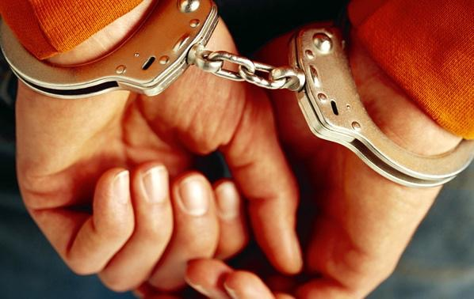
“Just because criminals live in houses, we don’t say that it is OK to search every house”

Slide 12
Solutions
Keep online information private!
  Use a feature called “Do not track” on your browser
  Be careful what you say online or over the phone
Vote for legislature to stop dragnet surveillance
  If you have a choice, try to vote against programs that collect information without a warrant

Slide 13
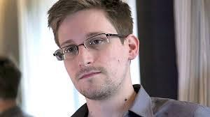
Solutions
Support whistleblowers such as Edward Snowden
  These people keep the government from becoming more powerful!

